Slide 1



Chemical Ingredient Transparency in Products: Review of Policies
& a Standard
May 20, 2020

Slide 2



Speakers
Topher Buck
Project Manager
Northeast Waste Management Officials’ Association
Terri Goldberg
Executive Director
Northeast Waste Management Officials’ Association
Mark S. Rossi, Ph.D.
Executive Director
Clean Production Action

Slide 3
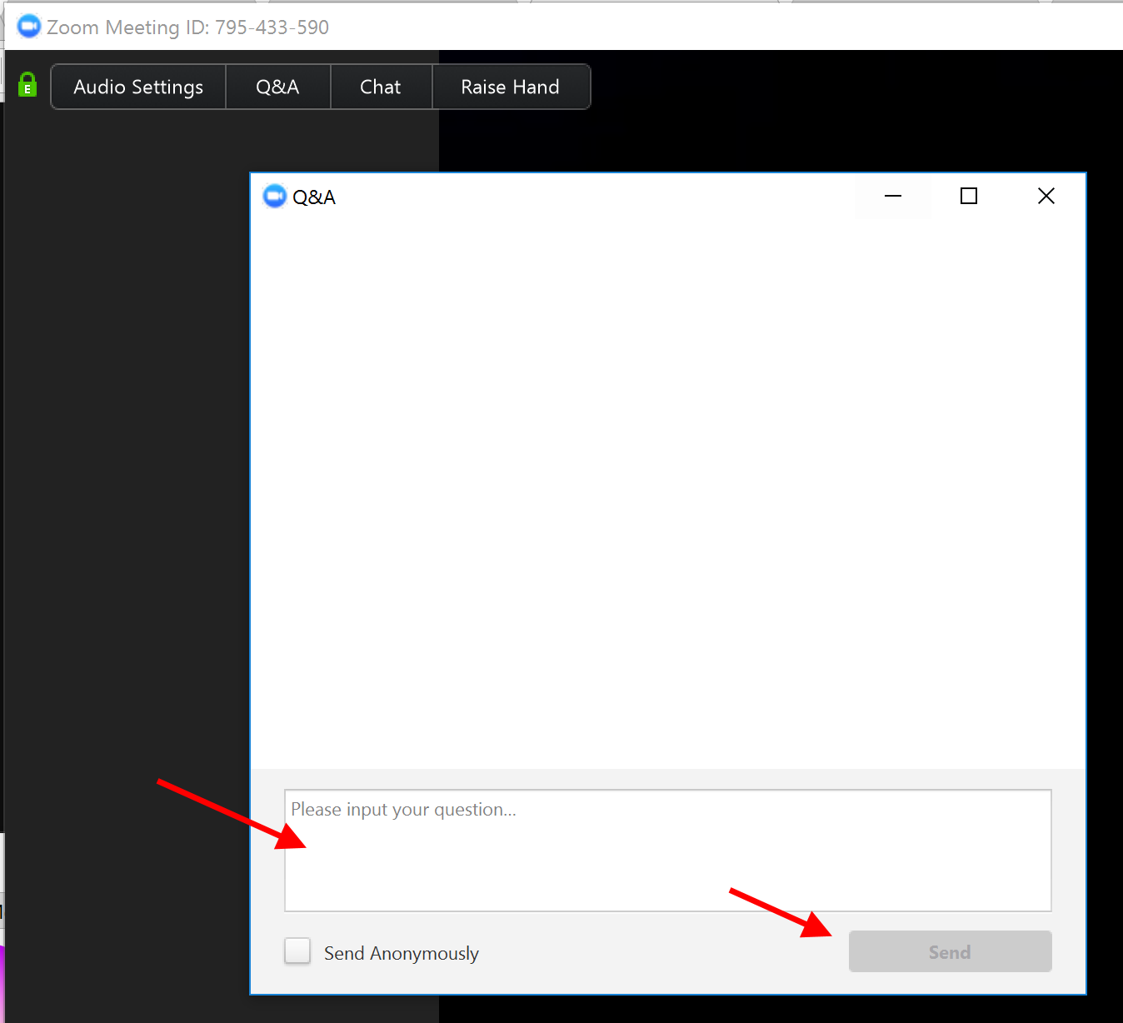
Zoom Webinar: Q&A

Slide 4

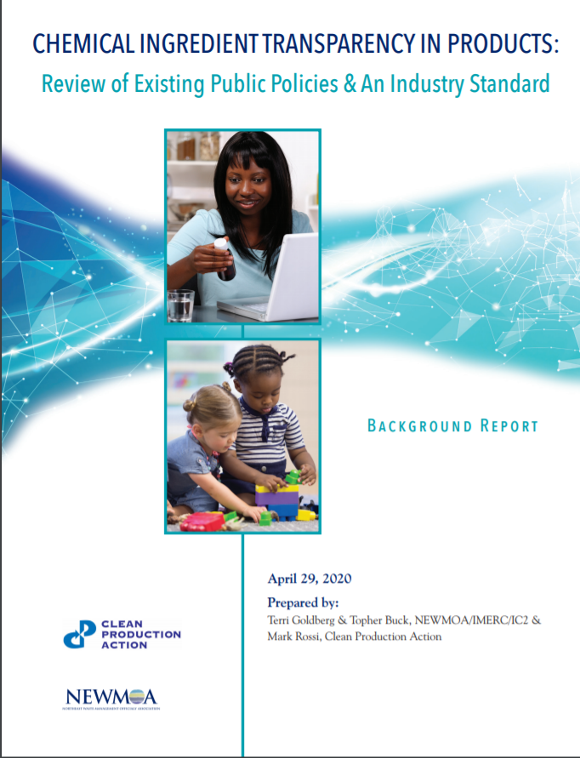
INTRODUCTION
CPA and IC2 have launched a partnership to find common ground among key stakeholders on chemical ingredient transparency policies and programs. This report provides context and summary information to help inform this initiative. The Review:
Discusses the purposes of chemical ingredient disclosure initiatives.
Examines many of the existing state ingredient disclosure initiatives, a voluntary standard, and their reporting requirements with the intent of identifying their similarities and differences.
Identifies and discusses key issues regarding existing public and voluntary disclosure programs.
The Appendix provides a matrix outlining key elements of the existing state mandatory disclosure requirements.

Slide 5
IC2 – CPA Report https://www.theic2.org/article/download-pdf/file_name/IC2-CPA_ChemicalDisclosure_ReviewPaper_FINAL.pdf

Slide 6
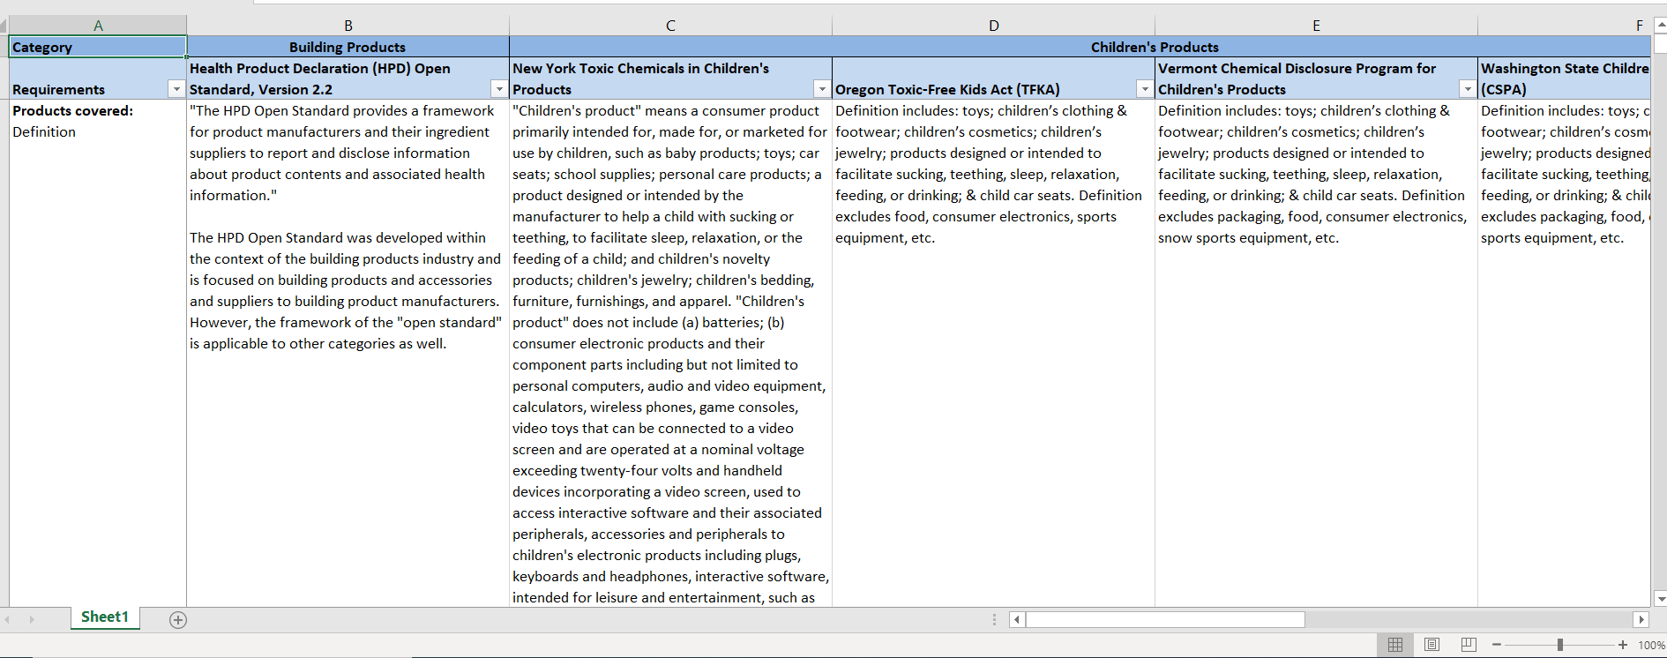
Spreadsheet
Download from https://www.theic2.org/publications

Slide 7
Outline
Goals
Existing Disclosure Models
Key Issues

Slide 8
Goals
States & voluntary standards are responding to demands for greater chemical ingredient transparency
Overall goals:
Provide public access to chemical ingredient information on the products consumers purchase & use—similar to food product ingredient labels—to support better-informed purchasing decisions
Promote wider awareness about the presence of chemicals of concerns in consumer products
Inform policies & programs designed to reduce chemicals of concern in products & the associated potential for exposure, particularly of workers & vulnerable populations
Inform efforts to promote safer substitution efforts for chemicals of concern
Enable programs to understand trends in targeted uses of high priority chemicals
Inform end-of-life management of the products that contain chemicals of concern

Slide 9
Universe of Information Users
Government agencies
Policy makers
Nongovernmental organizations (NGOs)
Researchers
Businesses, including brands & retailers, & their supply chains
Recyclers, waste managers, wastewater treatment facilities, & others that manage wastes, discharges, & releases
Public/consumers
Websites – i.e., EWG Skin Deep, what’sinproducts.com, Good Guide

Slide 10
Existing Models for Disclosure by Firms
Near full chemical ingredient disclosure for a category of products – CA Cleaning Product Right to Know Act, NYS Household Cleansing Product Information Disclosure Program, NY Menstrual Products Law, & the Health Product Declaration (HPD) Open Standard
Disclosure of chemical(s) of concern or class(es) of chemicals of concern in nearly all products – Mercury product reporting requirements enacted by 8 states (managed through IMERC)
Disclosure of chemicals of concern in a category of products – OR Toxic-Free Kids Act, WA State Children’s Safe Product Act, NY’s Children’s Products Disclosure, Maine’s Children’s Product Disclosure, VT Chemical Disclosure Program for Children’s Products (all managed through HPCDS), & Washington for Pollution Prevention for Healthy People & Puget Sound Act

Slide 11
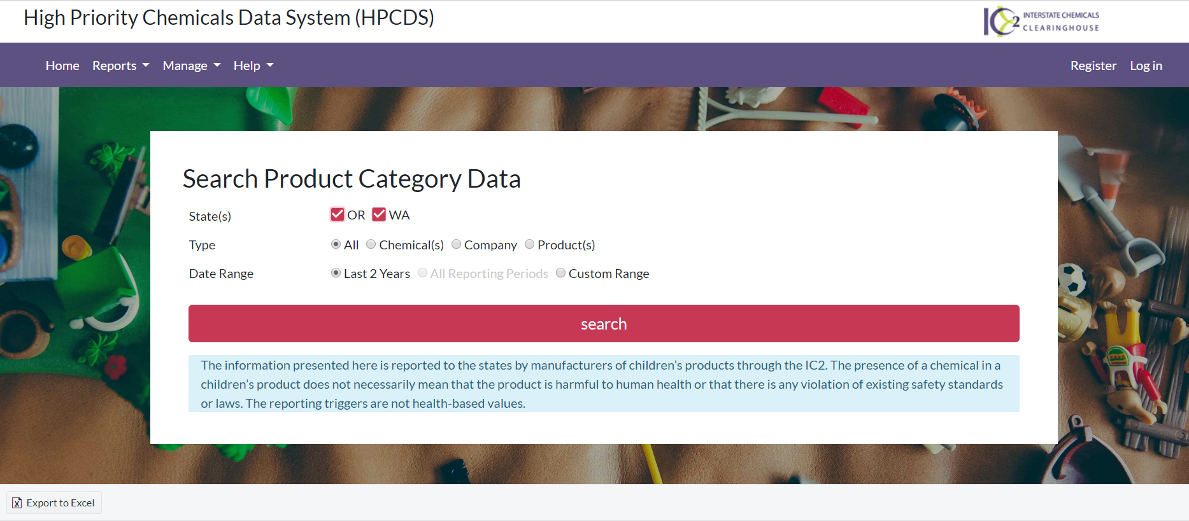
HPCDS

Slide 12

Health Product Declaration

Slide 13
Current Uses of the Information
Analyze chemical use trends for targeted products
Support public education campaigns on the use of chemicals of concern
Facilitate informed government & consumer purchasing decisions
Support alternatives assessments
Identify products/chemistries for green chemistry research & development.
Develop future chemical use compliance & enforcement efforts
Develop occupational health & safety measures
Inform product labeling
Initiate research on exposures to & substitutes for products & chemicals of concern
Inform improved & safer product use, pollution prevention initiatives, & end-of-life management strategies, including reuse, recycling, & treatment
Support further policy development & additional legislative action
Prioritization for product testing programs

Slide 14
Key Issues
Criteria for specifying chemicals for disclosure
Disclosure of chemical hazards
Threshold for intentionally added ingredients
Non-functional ingredients/incidental ingredients/contaminants
Scope of the products
Confidential business information (CBI)
Forms of disclosure & making the information accessible & usable
Compliance & enforcement
Using the information & deciding what actions to take

Slide 15
Specifying Chemicals of Concern for Disclosure
Depends on:
The goals of the overall program, such as reducing or eliminating the use of a high-priority toxic chemical or class of chemicals
The nature of the product—formulated or article (fabricated)
The users or consumers of the product, including sensitive populations, such as children or workers
What is already known about the chemicals in the targeted products & where information is missing, such as fragrances

Slide 16
Chemical Hazard Disclosure
Example - the Health Product Declaration (HPD) Open Standard requires, for each intentionally added substance & residual/impurity above the reporting threshold, the disclosure of the substance’s GreenScreen score & the hazards associated with each substance
Questions:
Who is demanding the chemical hazard profiles & who are the users of this information? For example, architects & builders for HPD
What is the form of the hazard disclosure – GreenScreen templates, warning labels (Prop. 65), others?

Slide 17
Thresholds for Reporting on Intentionally added Ingredients
The children’s product requirements set the limits for intentionally added ingredients as the practical quantification limit (PQL)
There are no reporting thresholds for mercury disclosure and product labeling or NY’s product labeling disclosure for menstrual products
The HPD Open Standard allows companies to report to different threshold levels, including 100 ppm & 1,000 ppm
Questions:
What is practical & knowable?
How to facilitate greater information on intentionally added ingredients within supply chains?
What’s the level of concern about intentional ingredients that may not meet the threshold for reporting?
Why would a product manufacturer intentionally add an ingredient at concentrations less than the PQL?

Slide 18
Non-functional Ingredients
Various perspectives:
Concern that toxic chemical(s) may be present as unknown contaminants
Creates incentives for manufacturers to take actions within their supply chains to reduce the contamination &/or to improve their own manufacturing processes to reduce contamination of products with chemicals that are not intentionally supposed to be in the product
Low level of contaminant(s) in the products present relatively low risk of possible exposure & therefore of less concern than the intentionally added ingredients
Levels of contaminants can vary from one production batch to another, which makes it difficult to accurately report on their presence
Cost of conducting testing of the products
Focus on intentionally added ingredients first

Slide 19
Confidential Business Information (CBI)
Most of the state laws allow for some CBI (a.k.a. trade secret) claims
Examples of CBI include:
Specific chemical identities
Market-share data, such as the number of products sold in the U.S. or a state in a year
Supply-chain relationships
Notes:
Note that Oregon’s Toxic-Free Kids Act (TFKA) requires manufacturers to disclose publicly the number of units sold or offered for sale in Oregon.

Slide 20
More on CBI
Companies are concerned about revealing the exact amounts of ingredients in their products
Several of the state requirements allow reporting of ingredient concentrations or amounts (by weight) in ranges
Examples include the mercury product requirements, & the OR, WA, & VT children’s products laws. By facilitating reporting in ranges, these state programs have avoided many CBI claims by manufacturers.
Should CBI apply to hazard information? SAICM’s position: “information on chemicals relating to the health & safety of humans & the environment should not be regarded as confidential”

Slide 21
Compliance & Enforcement
Clarity regarding who is responsible for enforcing the requirements or no authority to enforce the requirement/s
Clarity regarding the consequences of non-compliance
Resources available for compliance assistance & enforcement (argument for multi-state system)
Government resources for data reviews/analysis/product testing
Role of NGOs in oversight of program implementation & industry in self-policing

Slide 22
Other Issues
Balancing rights of states & their authorities with interstate commerce & complexity of multiple jurisdictional requirements

Slide 23
CPA & IC2
CPA designs & delivers strategic solutions for green chemicals, sustainable materials & environmentally preferable products. www.cleanproduction.org/
IC2 is an association of state, local, & tribal governments that promotes a clean environment, healthy communities, & a vital economy through the development & use of safer chemicals & products. www.theic2.org

Slide 24
Contacts
Terri Goldberg – tgoldberg@newmoa.org
Topher Buck – tbuck@newmoa.org
Mark Rossi – mark@cleanproduction.org

